Slide 1
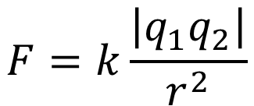
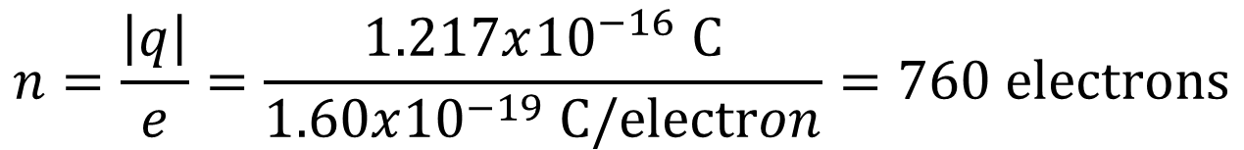
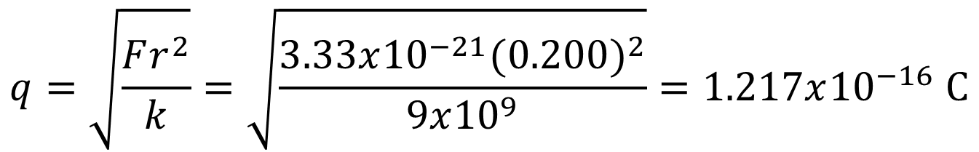
$$q=\sqrt{\frac{Fr^{2}}{k}}=\sqrt{\frac{3.33x{10}^{−21}{(0.200)}^{2}}{9x{10}^{9}}}=1.217x{10}^{−16} C$$
$$F=k\frac{\left|q_{1}q_{2}\right|}{r^{2}}$$
$$n=\frac{\left|q\right|}{e}=\frac{1.217x{10}^{−16} C}{1.60x{10}^{−19} C/electron}=760 electrons$$

Slide 3
21.11 . In an experiment in space, one proton is held fixed and another proton is released from rest a distance of 2.50 mm away. (a) What is the initial acceleration of the proton after it is released?

Slide 4
The two forces on q₃ must have equal magnitudes and opposite directions.
q3
q1
q2

